Slide 1
Landslide Risk Assessment Using Multi-source data and spatial analysis for wayanad district.
Thiyaneshwar T 2022115136
J Soham Panda 2022115024
Aniketh B Balaji 2022115052

Slide 2
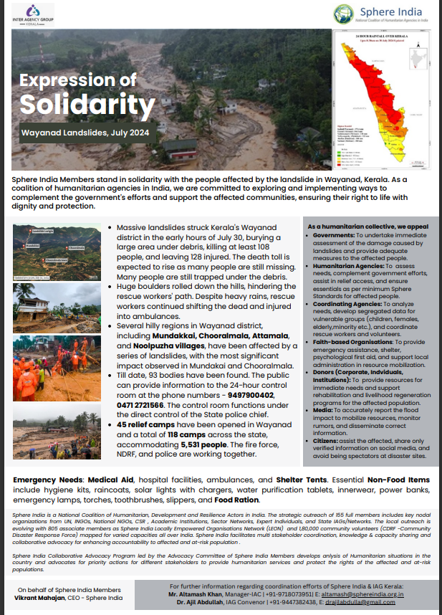
INTRODUCTION
India's increasing vulnerability to landslides, especially in regions like Uttarakhand and Kerala, has highlighted the urgent need for reliable prediction systems. Recent events, such as the landslide-blocked Badrinath National Highway in Uttarakhand and the deadly landslides in Wayanad, Kerala, have disrupted infrastructure, endangered lives, and devastated communities. With frequent monsoons exacerbating these risks, predictive systems based on satellite data and machine learning are crucial to assessing risks and improving early warning mechanisms, potentially saving lives and minimizing damage to critical infrastructure

Slide 3
AIM
To predict and analyze landslide occurrences while providing necessary risk assessments

Slide 4
OBJECTIVE
To create an advanced deep learning model that can analyze image datasets from remote sensing tools to accurately predict potential landslides.
To utilize remote sensing technology to continuously monitor environmental conditions in landslide-prone areas, providing real-time data for analysis.
To develop an intuitive interface where predictions are clearly communicated to users through a color-coded system and Voice based Prompt and answer, ensuring that critical information is easily accessible and actionable.

Slide 5
LITERATURE SURVEY BASE PAPERS
TITLE OF THE ARTICLE | JOURNAL/CONFERENCE DETAILS AND YEAR OF PUBLICATION | HIGHLIGHTS OF APPROACH(S) FOLLWED | CHALLENGES TO BE ADDRESSED
EVALUATING GEO-ASPECTS IMPLICATIONS ON LAND SLIDING IN HIMALAYAN TERRAIN IN A PART OF AIZWAL DISTRICT, MIZORAM STATE USING REMOTE SENSING AND GIS | Publisher: springer Date of conference:2006 | Generated thematic maps for various terrain parameters using visual interpretation of satellite images and topographical data. Digitized maps in ArcGIS 8.2 and aligned them to real-world coordinates using polyconic projection. Developed a Digital Elevation Model (DEM) from the contour layer, then generated slope and aspect maps. Created lineament and drainage density maps from lineament and drainage data. Computed area statistics of terrain parameters and calculated landslide density and frequency for analysis. | Integrating various thematic layers and maintaining consistency across different data sources are key concerns.
An integrated neural network method for landslide susceptibility assessment based on time-series InSAR deformation dynamic features | Published in: International Journal of Digital Earth Volume 17, Publisher: Taylor and francis Date of conference:2024 | LSA effectively fuses temporal InSAR deformation features with spatial landslide influencing factors. Analysis the Landslide influencing factors. Landslide cataloging Time series of InSAR deformation data. | InSAR technology used here is incoherent in some areas with dense vegetation or excessive deformation, leading to inaccurate deformation value.

Slide 6
LITERATURE SURVEY BASE PAPERS
TITLE OF THE ARTICLE | JOURNAL/CONFERENCE DETAILS AND YEAR OF PUBLICATION | HIGHLIGHTS OF APPROACH(S) FOLLWED | CHALLENGES TO BE ADDRESSED
DEM-Based Categorization of Landslides Induced by 2011 Sikkim Earthquake | Published in: 2019 International Conference on Intelligent Computing and Remote Sensing (ICICRS) Publisher: IEEE Date of conference:19-20 July 2019 | Landslide Categorization: Classification of landslides based on material (rock, debris, soil) and distance from the earthquake epicenter. Case Study: Analysis of landslides triggered by the 2011 Sikkim earthquake using Cartosat Digital Elevation Model (DEM) data. Impact of Rainfall and Earthquake: Exploration of how rainfall and seismic events contribute to landslide occurrences. Advancements in Satellite Imagery: Improvements in satellite image quality enhancing disaster risk reduction efforts. GIS Applications: Use of GIS software (e.g., ArcGIS, QGIS) for analyzing and mapping landslide data. | Limited satellite imagery in Inaccessible Areas Insufficient field data for regions impacted by the earthquake leads to gaps in understanding. Categorization Constraints

Slide 7
LITERATURE SURVEY DATA COLLECTION AND PREPROCESSING
TITLE OF THE ARTICLE | JOURNAL/CONFERENCE DETAILS AND YEAR OF PUBLICATION | HIGHLIGHTS OF APPROACH(S) FOLLWED | CHALLENGES TO BE ADDRESSED
Brazilian Midwest Native Vegetation Mapping Based on Google Earth Engine | Published in:2020 IEEE Latin American GRSS & ISPRS Remote Sensing Conference (LAGIRS) Publisher: IEEE Date of conference: 22-26 March 2020 | Evaluate Google Earth Engine (GEE) for mapping native and nonnative vegetation Spectral bands (blue to shortwave IR) NDVI mNDWI and Combinations of the above. | Processing Requirements External processing tool requirement.
NDVI COMPUTATION FROM HYPERSPECTRAL IMAGES | Published in:2023 13th Workshop on Hyperspectral Imaging and Signal Processing: Evolution in Remote Sensing (WHISPERS) Publisher: IEEE Date of conference: 31 October 2023 - 02 November 2023 | Band selection closest to Sentinel’s RED and NIR. Average reflectance over specified intervals. Weighted average using a Gaussian function. | Data Variability Differences in sensor specifications

Slide 8
LITERATURE SURVEY DATA PREPROCESSING
TITLE OF THE ARTICLE | JOURNAL/CONFERENCE DETAILS AND YEAR OF PUBLICATION | HIGHLIGHTS OF APPROACH(S) FOLLWED | CHALLENGES TO BE ADDRESSED
Multispectral Misregistration of Sentinel-2A Images: Analysis and Implications for Potential Applications | Published in: IEEE Geoscience and Remote Sensing Letters Publisher: IEEE Date of conference: November 2017 | Analyze subpixel misregistration in Sentinel-2A images for detecting moving targets and clouds Phase correlation detects subpixel shifts between B2, B3, and B4 images. Detected shifts >1.1 pixels for moving targets; identified clouds not included in the built-in mask. | Parallax angle leads to uncorrected shifts for moving/high-altitude objects
General and specific methods studying bands selection of hyperspectral remote sensing data | Published in: Proceedings. 2005 IEEE International Geoscience and Remote Sensing Symposium, 2005. IGARSS '05. Publisher: IEEE Date of conference: Dec 2005 | General Methods: Rough selection based on information content and band correlation. Specific Methods: Accurate selection considering band combinations, spectrum differences, and object separability. Importance of Spectral Resolution: Advances in spectral resolution enhance the extraction of detailed spectral information. Demonstration: Utilizes PHI data to illustrate methods and their application to real-world scenarios. | Data Redundancy Complex Selection Criteria Integration of Spatial Information

Slide 9
LITERATURE SURVEY FEATURE EXTRACTION
TITLE OF THE ARTICLE | JOURNAL/CONFERENCE DETAILS AND YEAR OF PUBLICATION | HIGHLIGHTS OF APPROACH(S) FOLLWED | CHALLENGES TO BE ADDRESSED
A QGIS Plug-in for Processing MODIS Data | Published in: 2019 IEEE 5th International Conference for Convergence in Technology (I2CT) Publisher: IEEE Date of conference: 29-31 March 2019 | Need for Pre-processing Tools: Effective tools are required to explore MODIS datasets fully. Open-source GIS Software Processing Steps: Includes conversion, re-projection, scaling, clipping, and time series analysis. Time Series Analysis: Essential for tracking changes in land surface temperature and vegetation indices. | Complexity of Satellite Data Scaling and Projection Requirements. Time Series Analysis Complexity
OpenStreetMap: Challenges and Opportunities in Machine Learning and Remote Sensing | Published in: IEEE Geoscience and Remote Sensing Magazine (Volume: 9) Publisher: IEEE Date of conference: March 2021 | Land Use Mapping: Combining OSM data with remote sensing imagery enables effective land cover classification. OSM is effective in finding: Street Networks Building Footprints Stream/water resource identification | Standardization of Tags: Improving the consistency and accuracy of semantic tags is essential Integration of Methods: integration into popular OSM editing tools (like iD Editor and JOSM) is limited.

Slide 10
LITERATURE SURVEY
TITLE OF THE ARTICLE | JOURNAL/CONFERENCE DETAILS AND YEAR OF PUBLICATION | HIGHLIGHTS OF APPROACH(S) FOLLWED | CHALLENGES TO BE ADDRESSED
A new approach for gridded risk assessment of rainfall-triggered flood and landslide hazards over a large region based on coupled flood-landslide modelling and ensemble simulation | Published in: Environmental Modelling & Software, Volume 172 Publisher: Science direct Date of conference:2024. | iCRESLIDE v2.0 model Integration of CREST hydrological model SLIDE landslide model | The iCRESLIDE v2.0 model is effective for small-scale, but larger areas require reducing spatial resolution, which might reduce the model's precision.
A multiscale feature fusion enhanced CNN with the multiscale channel attention mechanism for efficient landslide detection (MS2LandsNet) using medium-resolution remote sensing data | Published in: International Journal of Digital Earth Volume 17, 2024 Publisher: Taylor and francis Date of conference: 04 Jan 2024 | CNN for landslide detection using remote sensing imagery, named MS2LandsNet. Down-sampling : i) Multi-Scale Feature Fusion (MFF) ii) Multi-scale channel attention (MSCA) mechanisms. | Landslide pixels confused with sandy areas and the river banks as this model considers MR images.

Slide 11
LITERATURE SURVEY
TITLE OF THE ARTICLE | JOURNAL/CONFERENCE DETAILS AND YEAR OF PUBLICATION | HIGHLIGHTS OF APPROACH(S) FOLLWED | CHALLENGES TO BE ADDRESSED
Semantics-Consistent Representation Learning for Remote Sensing Image–Voice Retrieval | Published in: IEEE Transactions on Geoscience and Remote Sensing ( Volume: 60) Publisher: IEEE Date of conference: 05 March 2021 | Extracting high-level features of image by using pre-trained VGG16 network. Pairwise intra-modality, and non-paired inter-modality relationships analysed. | Works well for small scale image compared to large scale. Embedding Hashing code for large scale images.
Application of artificial intelligence in three aspects of landslide risk assessment: A comprehensive review | Published in: Rock Mechanics Bulletin, Volume 3, Issue 4, Publisher: Date of conference: 2024 | ML combines statistics and optimization for predictions. Supervised learning uses labeled data; unsupervised learning does not. DL includes CNNs for images, RNNs for sequences, and Transformers for long sequences. Metrics: accuracy, precision, recall, F1 score, IoU, RMSE, MAE, AUC. GUIs make ML accessible to non-experts. | The prediction of single point landslide Results can only reflect the deformation of the instrument installation position and cannot represent the overall deformation characteristics of a landslide.

Slide 12
LITERATURE SURVEY
TITLE OF THE ARTICLE | JOURNAL/CONFERENCE DETAILS AND YEAR OF PUBLICATION | HIGHLIGHTS OF APPROACH(S) FOLLWED | CHALLENGES TO BE ADDRESSED
Artificial Intelligence-Based Chatbot Model Providing Expert Advice to Potato Farmers in Kenya | Published in: IEEE AFRICON Publisher: IEEE Date of conference: 2023 | AI chatbot using IBM Watson Assistant and GIS technology to provide expert advice and connect farmers to certified potato seed producers. Data from the National Potato Council of Kenya and involved testing with 85 users, including farmers and agriculture students. The chatbot was evaluated using metrics such as message coverage, conversation containment, and user satisfaction | i) Conversation containment was 78.4%, revealing that 21.6% of interactions required escalation to human agents, indicating a need for improvement in handling complex queries. ii) User satisfaction was at 60%, suggesting room for enhancing the user experience.
RemoteCLIP: A Vision Language Foundation Model for Remote Sensing | Published in: Transactions on Geoscience and Remote Sensing Publisher: IEEE Date of conference: 2024 | Proposed a novel vision-language model for remote sensing by extending CLIP to handle remote sensing imagery. Includes data scaling to create a large-scale pretraining dataset, enabling the model to excel in zero-shot classification and retrieval tasks. | Scarcity of labeled data for pretraining; achieving high performance across diverse remote sensing datasets and applications

Slide 13
LITERATURE SURVEY
TITLE OF THE ARTICLE | JOURNAL/CONFERENCE DETAILS AND YEAR OF PUBLICATION | HIGHLIGHTS OF APPROACH(S) FOLLWED | CHALLENGES TO BE ADDRESSED
Chatbot for E-Learning | Published in: International Journal of Mechanical Engineering and Robotics Research ,in volume 7 Publisher: ETPub Date of conference: September 2018 | Modular Design Ontology-Based Petri Net navigation for workflow and conversation management. Adjusts responses based on user context Utilizes Latent Dirichlet Allocation to accurately match queries with learning objects. | Language Variation Response accuracy Scalability
A landslide extraction method of channel attention mechanism U-Net network based on Sentinel-2A remote sensing images | Published in: International Journal of Digital Earth Volume 16, publisher :Taylor and Francis Date of conference:2023 | Two Sentinel-2A for training a TensorFlow-based channel attention U-Net model to extract landslides. U-Net, U-Net Backbone, models compared and evaluated using relevant metrics. | Feature Channel Selection: Adjusting feature channel weights may lead to overfitting if not properly managed. Data Quality Variability: Variations in Sentinel-2A image quality and conditions can impact model performance. Generalization: Ensuring the model performs well across different regions and landslide types remains challenging.

Slide 14
LITERATURE SURVEY
TITLE OF THE ARTICLE | JOURNAL/CONFERENCE DETAILS AND YEAR OF PUBLICATION | HIGHLIGHTS OF APPROACH(S) FOLLWED | CHALLENGES TO BE ADDRESSED
Application of artificial intelligence in three aspects of landslide risk assessment: A comprehensive review | Published in: Rock Mechanics Bulletin, Volume 3, Publisher: IEEE Date of conference: 2024 | Review of AI applications in landslide detection, susceptibility assessment, and displacement prediction. Focus on ML, DL, and HM. Discusses the success of CNN and RNN in quantifying nonlinear soil structure relationships. | Need for improved generalization abilities, optimized sampling strategies, and hyperparameter tuning. Addressing the integration of explainable AI with physical models for more reliable predictions. Development of advanced GUI tools for broader AI adoption.
Visual Question Answering From Remote Sensing Images | Published in: IEEE International Geoscience and Remote Sensing Symposium, Yokohama, Japan, 2019 publisher: GARSS Date of conference:2019 - 2019 | Explored using natural language questions for extracting information from remote sensing images via Visual Question Answering (VQA). Automatically created a dataset using OpenStreetMap data. Developed a deep learning-based VQA model trained on the new dataset. Extracted visual features using CNN and RNN Combined visual and textual features for answer classification | Improving the dataset to include more variety in the questions, with potentially high-resolution data

Slide 15
LITERATURE SURVEY
TITLE OF THE ARTICLE | JOURNAL/CONFERENCE DETAILS AND YEAR OF PUBLICATION | HIGHLIGHTS OF APPROACH(S) FOLLWED | CHALLENGES TO BE ADDRESSED
Attention-Based YOLOv5 Model For Enhancing Landslide Detection In Remote Sensing Imagery | Published in: IEEE India Geoscience and Remote Sensing Symposium (GARSS), Bangalore, India, Publisher: GARSS Date of conference:2023 | Converted dataset annotations to YOLO format and YAML configuration file. Used YOLOv5 (small variant) with CBAM and ECA attention mechanisms integrated into the backbone. Trained for 500 epochs with a batch size of 8 and image size of 640x640 on a system with NVIDIA RTX 3080 Ti GPU. Evaluated using f-score, precision, recall, and mean Average Precision (mAP). | Potential overfitting due to high mAP scores; real-world performance might differ. Limited evaluation to only two attention modules (CBAM and ECA); other models might perform differently.

Slide 16
SUMMARY OF LITERATURE SURVEY
Landslide Risk Mapping and Analysis: Multiple papers focus on using GIS software like ArcGIS and QGIS, combined with satellite data (e.g., Sentinel, Cartosat), to create detailed thematic maps, slope, aspect, and terrain analysis. These maps help calculate landslide density, frequency, and risk in areas affected by natural factors such as rainfall, earthquakes, and geology.
Neural Networks for Landslide Detection: InSAR data and neural network models (e.g., MS2LandsNet) are used to fuse temporal deformation data with spatial features to predict landslides.
Spectral Band Analysis: Papers emphasize the use of NDVI and mNDWI for vegetation and water body analysis, which are critical indicators of landslide risk. Accurate band selection (e.g., NIR, SWIR) and spectral resolution are highlighted as essential for extracting meaningful geospatial data.
Data Integration and Preprocessing: A focus is placed on preprocessing tools for datasets (e.g., MODIS, Sentinel) and the integration of models like iCRESLIDE with hydrological and landslide models, which improve risk modeling for complex terrains.

Slide 17

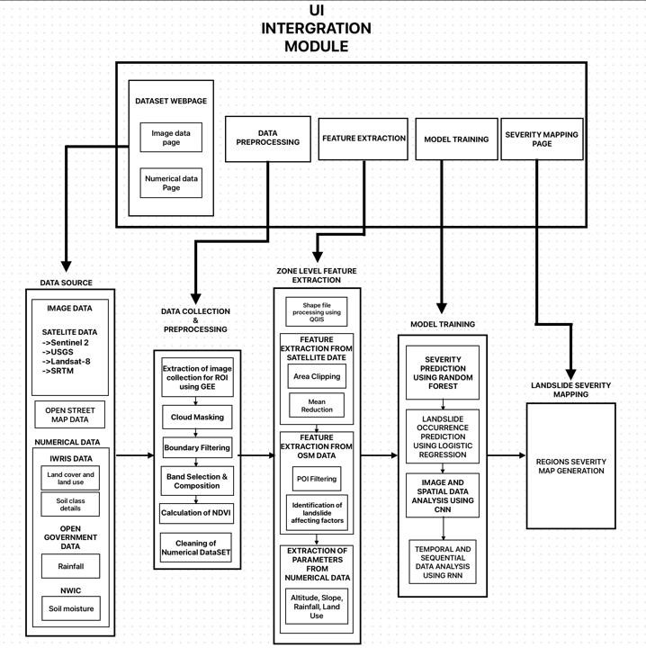
System Architecture

Slide 18

Details of Data - Image
SENTINEL 2
Platform: Google Earth Engine Editor (GEE) Feature: Normalized Difference Vegetation Index(NDVI) Resolution: 10 m
Format and Size: Tiff file Collected from 2015 to 2024 (100 images - 5.5 GB)
USGS
Platform: Google Earth Engine Editor(GEE)
Feature: Elevation using SRTM
Resolution: 30 m
Format and Size: Tiff file Collected from 2017 to 2024 (50 images – 1.8 GB)
LANDSAT 8
Platform: United States Geological Survey (USGS)
Feature: Topographical nature. Resolution: 15 -30 m
Format and Size: Tiff file from 2017 to 2024 (60 images – 7 GB)
OSM
Platform: Open Street Maps
(OSM)
Feature: Distance of road and water from POI Format and size: .osm for interior parts of Wayanad around 25 images.

Slide 19
Details of Data - Numerical
Land cover & Land Use
Platform: India Water Resource Information System (IWRIS) Features: Classes and area covered from 2018 – 2024.
Format and Size: CSV – 100 cells for Wayanad.
Soil class Details
Platform: India Water Resource Information System (IWRIS)
Features: Soil Depth, Soil Erosion, Soil Productivity, Soil texture from 2015-2024.
Format and Size: CSV, around 190 cells for each feature.
RAINFALL
Platform: Open Government Data (OGP)
Feature: Month-wise rainfall distribution from 2000 – 2024. Format and Size: CSV, around 2300 cells of data.
Soil Moisture
Platform: National Water Informatics Centre.(NWIC)
Features: Month-wise volumetric percentage of moisture from 2018-2024
Format and size: CSV, around 50000 cells of data.

Slide 20
DATA PROCESSING
Dept of IST,CEG ,Anna University

Slide 21
Algorithm
Input : Satellite name, band information
Step 1: Import the required satellite data Filter the data according to time and region of interest
Step 2: Perform cloud masking if required Select the proper bands
Step 3: Using the bands apply formula if applicable Return the processed image
Output : Processed satellite image
Dept of IST,CEG ,Anna University

Slide 22
Processing of Sentinel 2 Images:
High spatial resolution (10m, 20m, 60m)
13 spectral bands for diverse land monitoring
Atmospheric correction for surface reflectance (Level-2A)
Frequent revisit time (5 days)
Free and open access to data
Global coverage with wide swath
Features Extracted From Harmonized Sentinel-2 MSI: Multi Spectral Instrument, Level-2A:
Normalized Difference Vegetation Index(NDVI)
Dept of IST,CEG ,Anna University

Slide 23
Algorithm for processing Sentinel 2 images
Step 1: Define Region:
Create a rectangle geometry representing Kerala as the Region of Interest (ROI).
Step 2: Load Sentinel-2 Image Collection:
Retrieve Sentinel-2 images over the Kerala region for the particular period
Step 3: Median Composite (Raw Data):
Compute the median composite of the raw image collection without any cloud masking.
Clip the raw median composite to the Kerala region.
Band Selection for Raw Data:
Select RGB bands (B4 for Red, B3 for Green, B2 for Blue) for raw data visualization.
Display the raw RGB cposite on the map.
Dept of IST,CEG ,Anna University

Slide 24
Algorithm for processing Sentil-2 images
Step 5: Cloud Masking Function:
Use the QA60 band to detect clouds using bitwise operations (bit 10 indicates cloud)
Mask out the cloudy pixels where clouds are detected.
Step 6: Apply Cloud Masking:
Apply the cloud masking function to the image collection.
Compute the median composite of the cloud-masked images.
Clip the processed image collection to the Kerala region.
Step 7: Band Selection for Processed Data:
Select the same RGB bands (B4, B3, B2) for cloud-masked RGB visualization.
Add the processed RGB composite to the map.
Step 8: False Color Composite:
Select the Near-Infrared (B8), Red (B4), and Green (B3) bands to create a false color composite for better vegetation and land-use differentiation.
Add the false color composite to the map for improved visualization.
Dept of IST,CEG ,Anna University

Slide 25
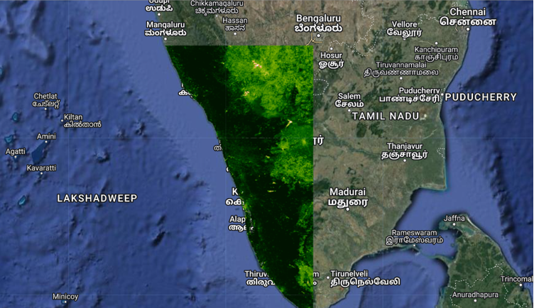
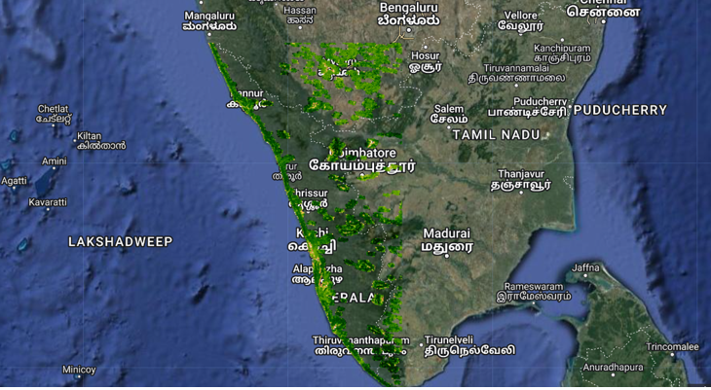
Differentiation
Before Processing:
After Cloud Masking:
Dept of IST,CEG ,Anna University

Slide 26
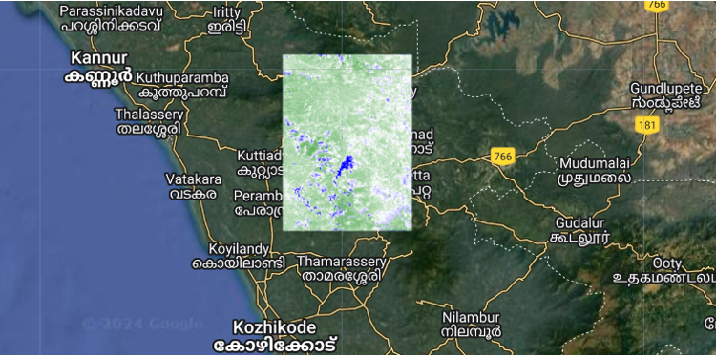
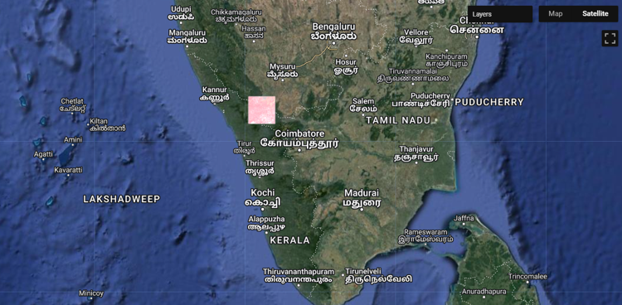
Differentiation
After Band Selection:
After Boundary Filtering and Visualization:
Dept of IST,CEG ,Anna University

Slide 27
Normalized Difference Vegetation Index(NDVI)
NDVI is a widely used remote sensing index that measures vegetation health by comparing the difference between near-infrared (NIR) and red light reflectance captured by satellites. Vegetation reflects more NIR light and absorbs red light, so NDVI helps assess plant biomass and health.
Inputs:
Near-Infrared Band (B8): Captures reflectance of NIR light, which is strongly reflected by healthy vegetation.
Red Band (B4): Captures reflectance of red light, which is absorbed by vegetation.
Steps:
Select the Near-Infrared (B8) and Red (B4) bands from the Sentinel-2 image collection.
Apply the normalizedDifference function using the selected bands to compute the NDVI.
Dept of IST,CEG ,Anna University

Slide 28
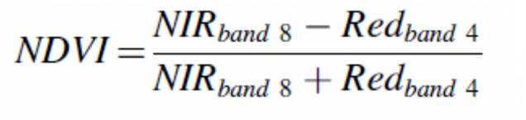
Normalized Difference Vegetation Index(NDVI)
Output:
NDVI Value Range:
The resulting NDVI values range from -1 to 1:
Negative values: Indicate non-vegetated surfaces, like water, built-up areas, or clouds.
Near 0 values: Indicate bare soil or sparsely vegetated areas.
Positive values (closer to 1): Indicate healthy, dense vegetation.
Dept of IST,CEG ,Anna University

Slide 29
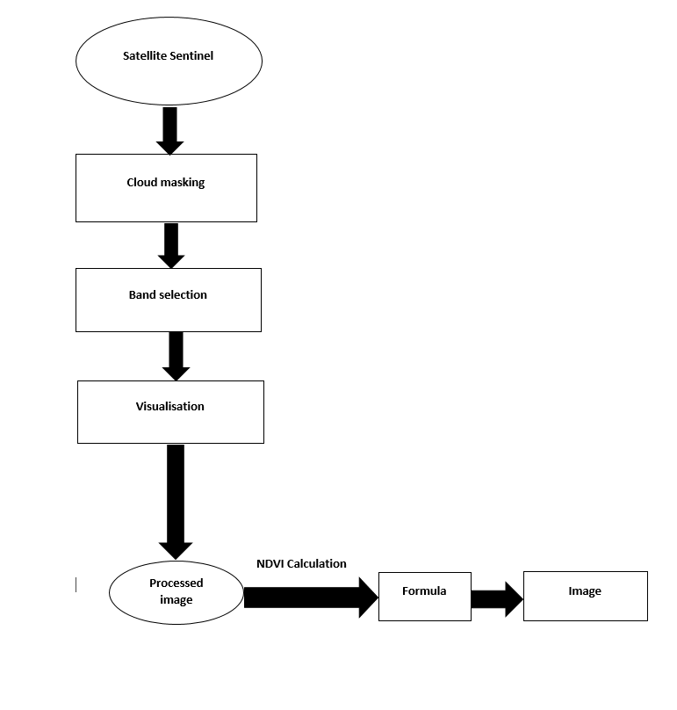
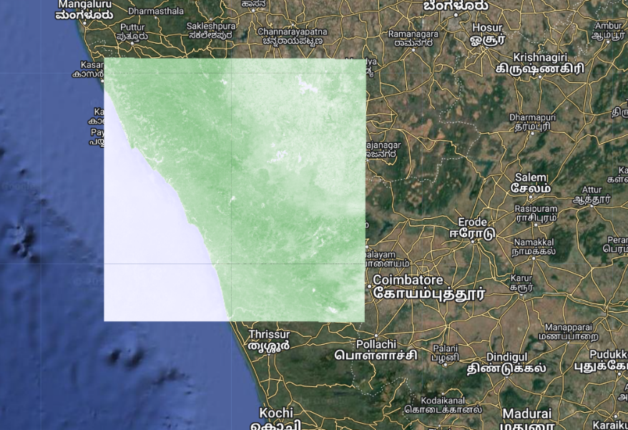
Data Preprocessing Architecture
Dept of IST,CEG ,Anna University

Slide 30
FEATURE EXTRACTION
Dept of IST,CEG ,Anna University

Slide 31
AOI Clipping
Input: Satellite image collection, AOI (Wayanad), Cloud masking function
Step 1: Filter and Prepare Data:
Define geometries for AOI and broader region.
Filter the satellite image collection by date and location.
Apply cloud masking to each image in the collection.
Step 2: Create Composite Image:
Generate a median composite image from the cloud-masked collection.
Clip to AOI:
Clip the composite image to the defined AOI (Wayanad).
Visualize and Export:
Visualize the clipped image on the map.
Export the clipped image (RGB and/or False Color composites) to Google Drive.
Output:
Clipped Satellite Image: RGB and False Color composites, clipped to the AOI (Wayanad), ready for analysis or export.
Dept of IST,CEG ,Anna University

Slide 32
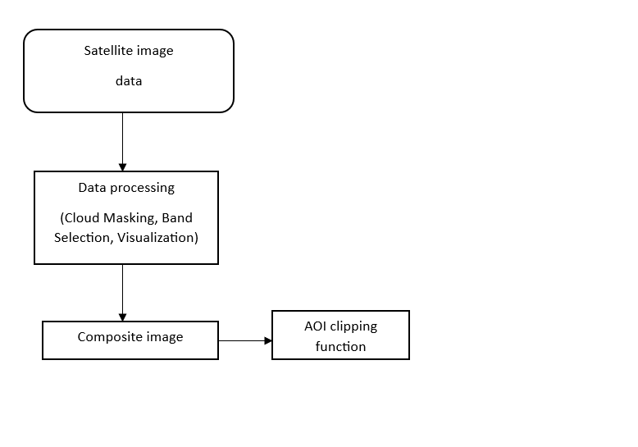
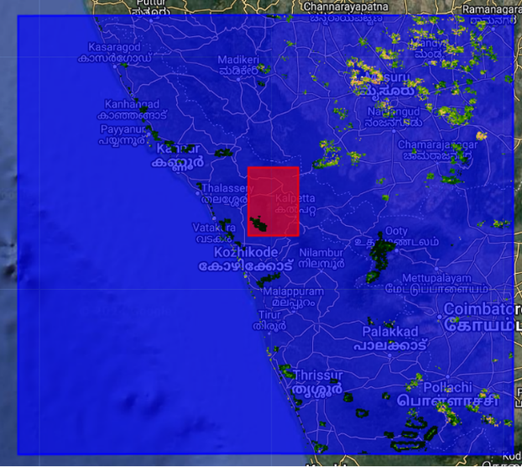
AOI Clipping Architecture
Dept of IST,CEG ,Anna University

Slide 33
SLOPE FEATURE EXTRACTION (SLOPE CSV)
SRTM (Shuttle Radar Topography Mission) provides global elevation data with a spatial resolution of 30 meters, capturing the Earth's surface topography. DEM (Digital Elevation Model) represents terrain elevation, allowing for the extraction of slope data. By calculating the rate of elevation change between neighboring pixels in a DEM, the slope can be derived, which is crucial for understanding terrain steepness and potential landslide risks.
This step involves extracting elevation data from GEE and exporting it as a TIFF file.
Calculate slope: In QGIS, terrain slope is calculated from the DEM using built-in analysis tools.
Raster to point conversion: Slope raster is converted into points for easy data extraction.
Export to CSV: Export the point data (with slope values) to a CSV file for further analysis.
Dept of IST,CEG ,Anna University

Slide 34
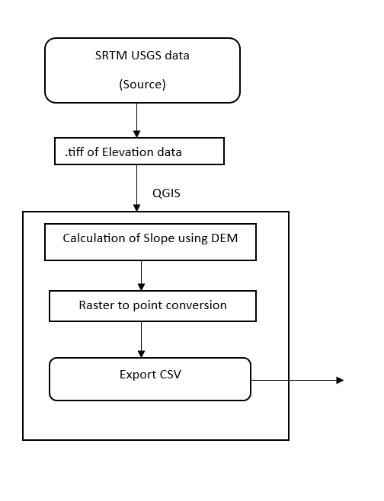
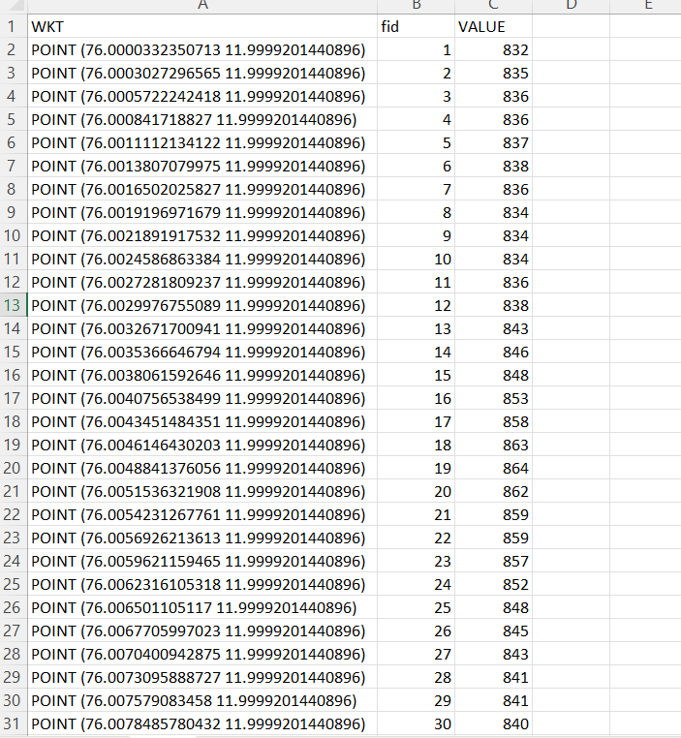
Architecture of SLOPE FEATURE EXTRACTION (SLOPE CSV)
Dept of IST,CEG ,Anna University

Slide 35
FEATURE EXTRACTION USING OSM IMAGE
Input: OSM data, QGIS software
Step 1: Load OSM Data:
Import the OSM data file into QGIS using Vector -> OpenStreetMap -> Load Data.
Step 2: Filter Data:
Use the Query Builder or Filter tool to select relevant features, such as highways, buildings, or points of interest.
Step 3: Select AOI:
Define and select areas of interest (e.g., Mundakkai and Chooralmala) by drawing polygons or using the Select by Location tool.
Step 4: Export to CSV:
Right-click the filtered layer, choose Export -> Save Features As..., select CSV, and save the file.
Output:
CSV File: Contains detailed data (highways, buildings, etc.) for the specified areas
Dept of IST,CEG ,Anna University

Slide 36
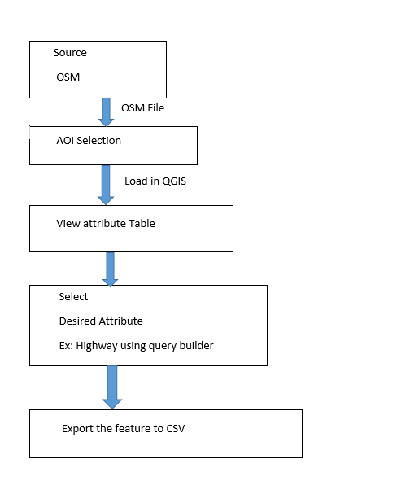
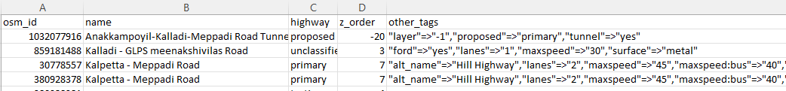
ARCHITECTURE OF FEEATURE EXTRACTION USING OSM IMAGE
Dept of IST,CEG ,Anna University

Slide 37
FEATURE EXTRACTION USING NDVI IMAGE
Input: NDVI data, QGIS software
Step 1: Load NDVI Data
Import the NDVI data file into QGIS using Raster -> NDVI Image-> Load Data.
Step 2: Region of extent to clip
Using the clip raster to extent tool the specific areas (e.g., Mundakkai and Chooralmala) on Wayanad is clipped for extraction of NDVI.
Step 3: NDVI value extraction
Using Raster to Points conversions the NDVI value for each specific latitude and longitude are extracted.
Step 4: Export to CSV:
Right-click the filtered layer, choose Export -> Save Features As..., select CSV, and save the file.
Output:
CSV File: Contains data of (Geometric point and corresponding NDVI value) for the specified areas
Dept of IST,CEG ,Anna University

Slide 38
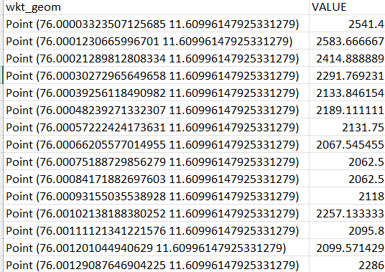
ARCHITECTURE OF FEEATURE EXTRACTION USING NDVI IMAGE
Source NDVI Image
Raster Image
Clip extent selection
Raster to point conversion
Select NDVI value from the attribute table
Dept of IST,CEG ,Anna University

Slide 39
MODEL TRAINING
Dept of IST,CEG ,Anna University

Slide 40
LANDSLIDE PREDICTION MODEL
Overview:
The core objective of model training is to analyze and predict landslide risks by learning patterns from multi-source geospatial data.
The Random Forest (RF) algorithm is used for this purpose, chosen for its robustness and ability to handle complex, nonlinear relationships between input features.
INPUT: NDVI, Slope, Rainfall, Land Use Land Cover, Soil Moisture OUTPUT: Prediction of the occurrence of landslide
Steps involved
Data Preparation:
Multi-source datasets are collected and preprocessed, including NDVI, soil moisture, rainfall, slope, and land use/land cover (LULC).
Data extraction involves:
Clipping raster data for regions like Mundakkai,Chooralmala, Meppadi, Vythiri using QGIS.
Converting environmental features into numerical data, which is then exported in CSV format for integration.
Dept of IST,CEG ,Anna University

Slide 41
Feature Engineering:
Features such as NDVI values, soil moisture levels, rainfall patterns, slope gradients, and land cover classifications are analyzed to understand their role in landslide occurrences.
Each feature is assigned a risk factor based on predefined thresholds (e.g., soil moisture < 25%, NDVI thresholds).
Model Selection – Random Forest Algorithm:
The Random Forest (RF) algorithm is utilized due to its:
Ability to handle high-dimensional data.
Capability to capture non-linear relationships between features.
Robustness against overfitting by averaging multiple decision trees.
Risk Factor Calculation:
Calculation of the risk factors based on specific thresholds and normalizing them. This involves creating three new columns in the dataset that represent different risk factors related to landslide occurrence:
Risk Factor_x: Calculated based on slope values.
Risk Factor_y: Based on NDVI values.
Risk Factor_z: Derived from annual data.
The Landslide Probability is computed as a weighted sum of the risk factors.
Landslide Occurrence Classification:
Creating a new column Landslide Occurrence based on the calculated Landslide Probability, indicating whether a landslide is likely to occur.
Dept of IST,CEG ,Anna University

Slide 42
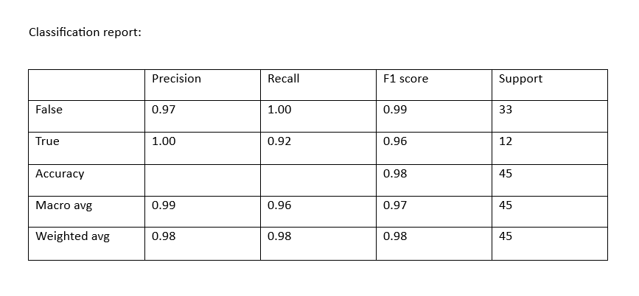
Feature and Target Definition:
Features are defined by dropping the Landslide Probability, and the target variable is the binary column indicating landslide occurrence (i.e., Landslide Occurrence_YES).
Training & Validation:
Data is split into training and validation sets.
The model learns patterns from the training set, considering the impact of multiple features on landslide risks.
Validation set helps in evaluating the model's predictive performance and reducing errors.
Risk Prediction & Analysis:
Once trained, the RF model can predict landslide risks for new data inputs.
Risk assessments provide insights into areas requiring preventive measures and can be used for severity mapping model.
Dept of IST,CEG ,Anna University

Slide 43
References
[1] Everton da Silva Maldonado , Emad Shihab , Nikolaos Tsantalis, “Using Natural Language Processing to Automatically Detect Self-Admitted Technical Debt” IEEE Transactions on Software Engineering, Volume: 43, Issue: 11, pages:30-45, Nov. 1 2017.
[2] He, Y., Zhao, Z., Zhu, Q., Liu, T., Zhang, Q., Yang, W., … Wang, Q. (2023). An integrated neural network method for landslide susceptibility assessment based on time-series InSAR deformation dynamic features. International Journal of Digital Earth, 17(1). https://doi.org/10.1080/17538947.2023.2295408.
[3] Gulab, Singh. “EVALUATING GEO-ASPECTS IMPLICATIONS ON LAND SLIDING IN HIMALAYAN TERRAIN IN A PART OF AIZWAL DISTRICT , MIZORAM STATE USING REMOTE SENSING AND GIS.” (2006).
[4] Lu, W., Hu, Y., Shao, W., Wang, H., Zhang, Z., & Wang, M. (2024). A multiscale feature fusion enhanced CNN with the multiscale channel attention mechanism for efficient landslide detection (MS2LandsNet) using medium-resolution remote sensing data. International Journal of Digital Earth, 17(1). https://doi.org/10.1080/17538947.2023.2300731.
[5]S. Lobry, J. Murray, D. Marcos and D. Tuia, "Visual Question Answering From Remote Sensing Images," IGARSS 2019 - 2019 IEEE International Geoscience and Remote Sensing Symposium, Yokohama, Japan, 2019, pp. 4951-4954, Doi: 10.1109/IGARSS.2019.8898891.
[5]S. Lobry, J. Murray, D. Marcos and D. Tuia, "Visual Question Answering From Remote Sensing Images," IGARSS 2019 - 2019 IEEE International Geoscience and Remote Sensing Symposium, Yokohama, Japan, 2019, pp. 4951-4954, Doi: 10.1109/IGARSS.2019.8898891.
Dept of IST,CEG ,Anna University

Slide 44
[6]N. Chandra and H. Vaidya, "Attention-Based YOLOv5 Model For Enhancing Landslide Detection In Remote Sensing Imagery," 2023 IEEE India Geoscience and Remote Sensing Symposium (In GARSS), Bangalore, India, 2023, pp. 1-4, Doi: 10.1109/InGARSS59135.2023.10490427.
[7]H. Ning, B. Zhao and Y. Yuan, "Semantics-Consistent Representation Learning for Remote Sensing Image–Voice Retrieval," in IEEE Transactions on Geoscience and Remote Sensing, vol. 60, pp. 1-14, 2022, Art no. 4700614, Doi: 10.1109/TGRS.2021.3060705.
[8]Zhang, Jie and Ma, Xiangyu and Lu, Meng and Sharma, Atma and Zhang, Lulu, Assessing Highway Resilience Subjected to Rainfall-Induced Slope Failure. Available at SSRN: http://dx.doi.org/10.2139/ssrn.4907082.
[9]Ruohan Wang , Guan Chen, Yong Liu, Michael Beer,
Computational modeling of near-fault earthquake-induced landslides considering stochastic ground motions and spatially varying soil,
Engineering Structures, Volume 316,2024,118580,SSN 0141-0296.
[10] F. Liu et al., "Remote CLIP: A Vision Language Foundation Model for Remote Sensing," in IEEE Transactions on Geoscience and Remote Sensing, vol. 62, pp. 1-16, 2024, Art no. 5622216, Doi: 10.1109/TGRS.2024.3390838.
[11] J. E. Vargas-Munoz, S. Srivastava, D. Tuia and A. X. Falcão, "OpenStreetMap: Challenges and Opportunities in Machine Learning and Remote Sensing," in IEEE Geoscience and Remote Sensing Magazine, vol. 9, no. 1, pp. 184-199, March 2021, doi: 10.1109/MGRS.2020.2994107.
Dept of IST,CEG ,Anna University

Slide 45
[12]M. K. Korir, W. Mwangi and M. W. Kimwele, "Artificial Intelligence-Based Chatbot Model Providing Expert Advice to Potato Farmers in Kenya," 2023 IEEE AFRICON, Nairobi, Kenya, 2023, pp. 1-6, doi: 10.1109/AFRICON55910.2023.10293557.
[13] Francesco Colace, Massimo De Santo, Marco Lombardi, Francesco Pascale, Antonio Pietrosanto, and Saverio Lemma, "Chatbot for E-Learning: A Case of Study," International Journal of Mechanical Engineering and Robotics Research, Vol. 7, No. 5, pp. 528-533, September 2018. DOI: 10.18178/ijmerr.7.5.528-533.
[14]Chen, H., He, Y., Zhang, L., Yao, S., Yang, W., Fang, Y., … Gao, B. (2023). A landslide extraction method of channel attention mechanism U-Net network based on Sentinel-2A remote sensing images. International Journal of Digital Earth, 16(1), 552–577. https://doi.org/10.1080/17538947.2023.2177359. [15] S. Skakun, E. Vermote, J. -C. Roger and C. Justice, "Multispectral Misregistration of Sentinel-2A Images: Analysis and Implications for Potential Applications," in IEEE Geoscience and Remote Sensing Letters, vol. 14, no. 12, pp. 2408-2412, Dec. 2017, doi: 10.1109/LGRS.2017.2766448.
[16] Wei Zheng, Zhang Xia, Zhang Bing and Li Xing, "General and specific methods studying on bands selection of hyperspectral remote sensing data," Proceedings. 2005 IEEE International Geoscience and Remote Sensing Symposium, 2005. IGARSS '05., Seoul, 2005, pp. 3223-3226, doi: 10.1109/IGARSS.2005.1526527.
Dept of IST,CEG ,Anna University

Slide 46
[17] I. C. Plajer, A. Băicoianu, L. Majercsik and M. Ivanovici, "NDVI Computation from Hyperspectral Images," 2023 13th Workshop on Hyperspectral Imaging and Signal Processing: Evolution in Remote Sensing (WHISPERS), Athens, Greece, 2023, pp. 1-5, doi: 10.1109/WHISPERS61460.2023.10431225.
[18] N. V. Estrabis et al., "Brazilian Midwest Native Vegetation Mapping Based on Google Earth Engine," 2020 IEEE Latin American GRSS & ISPRS Remote Sensing Conference (LAGIRS), Santiago, Chile, 2020, pp. 613-618, doi: 10.1109/LAGIRS48042.2020.9165607.
[19] J. -k. Liu, D. Liu and D. Alsdorf, "Extracting Ground-Level DEM From SRTM DEM in Forest Environments Based on Mathematical Morphology," in IEEE Transactions on Geoscience and Remote Sensing, vol. 52, no. 10, pp. 6333-6340, Oct. 2014, doi: 10.1109/TGRS.2013.2296232.
[20] A. Aishwarya Hegde, U. Pruthviraj and A. Shetty, "A QGIS Plug-in for Processing MODIS Data," 2019 IEEE 5th International Conference for Convergence in Technology (I2CT), Bombay, India, 2019, pp. 1-4, doi: 10.1109/I2CT45611.2019.9033711.
[21] A. Sridharan and S. Gopalan, "DEM Based Categorisation of Landslides Induced by 2011 Sikkim Earthquake," 2019 International Conference on Intelligent Computing and Remote Sensing (ICICRS), Bhubaneswar, India, 2019, pp. 1-4, doi: 10.1109/ICICRS46726.2019.9555880.
Dept of IST,CEG ,Anna University

Slide 47
THANK YOU

